Slide 1



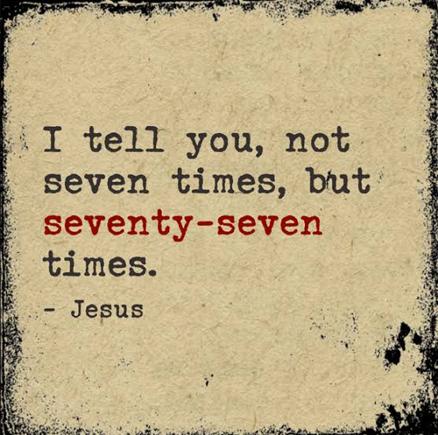
Westmead Catholic Community
Parish Heartbeats
Official Weekly Bulletin of Sacred Heart Parish, Westmead
Parish Office: 14 Ralph Street, Westmead NSW 2145 Telephone: 9635 9262
Email Address: office@sacredheartwestmead.com.au Website: www.sacredheartwestmead.com.au
‘The sacred heart of Jesus is an open heart . . .’ St Teresa of Kolkata
24th Sunday in Ordinary Time 12 – 13 September 2026
Entrance Antiphon Sir 36:18
Give peace, O Lord,
to those who wait for you,
that your prophets be found true.
Hear the prayers of your servant,
and of your people Israel.
First Reading Sir 27:30 - 28:7
Resentment and anger, these are foul things, and both are found with the sinner. He who exacts vengeance will experience the vengeance of the Lord, who keeps strict account of sin. Forgive your neighbour the hurt he does you, and when you pray, your sins will be forgiven. If a man nurses anger against another, can he then demand compassion from the Lord? Showing no pity for a man like himself, can he then plead for his own sins? Mere creature of flesh, he cherishes resentment; who will forgive him his sins? Remember the last things, and stop hating, remember dissolution and death, and live by the commandments. Remember the commandments, and do not bear your neighbour ill-will; remember the covenant of the Most High, and overlook the offence.
Responsorial Psalm Ps 102:1-4. 9-12. R.v.8 R. The Lord is kind and merciful;
slow to anger and rich in compassion.
1. My soul, give thanks to the Lord,
all my being, bless his holy name.
My soul, give thanks to the Lord
and never forget all his blessings. R.
2. It is he who forgives all your guilt,
who heals every one of your ills,
who redeems your life from the grave,
who crowns you
with love and compassion. R.
3. His wrath will come to an end;
he will not be angry for ever.
He does not treat us according to our sins
nor repay us according to our faults. R.
4. For as the heavens
are high above the earth
so strong is his love for those who fear him.
As far as the east is from the west
so far does he remove our sins. R.
Second Reading Rom 14:7-9
The life and death of each of us has its influence on others; if we live, we live for the Lord; and if we die, we die for the Lord, so that alive or dead we belong to the Lord. This explains why Christ both died and came to life, it was so that he might be Lord both of the dead and of the living.
Gospel Acclamation Jn 13:34
Alleluia, alleluia!
I give you a new commandment:
love one another as I have loved you. Alleluia!
Gospel Mt 18:21-35
Peter went up to Jesus and said, ‘Lord, how often must I forgive my brother if he wrongs me? As often as seven times?’ Jesus answered, ‘Not seven, I tell you, but seventy-seven times. ‘And so the kingdom of heaven may be compared to a king who decided to settle his accounts with his servants. When the reckoning began, they brought him a man who owed ten thousand talents; but he had no means of paying, so his master gave orders that he should be sold, together with his wife and children and all his possessions, to meet the debt. At this, the servant threw himself down at his master’s feet. “Give me time,” he said “and I will pay the whole sum.” And the servant’s master felt so sorry for him that he let him go and cancelled the debt. Now as this servant went out, he happened to meet a fellow servant who owed him one hundred denarii; and he seized him by the throat and began to throttle him. “Pay what you owe me”, he said. His fellow servant fell at his feet and implored him, saying, “Give me time and I will pay you.” But the other would not agree; on the contrary, he had him thrown into prison till he should pay the debt. His fellow servants were deeply distressed when they saw what had happened, and they went to their master and reported the whole affair to him. Then the master sent for him. “You wicked servant,” he said. “I cancelled all that debt of yours when you appealed to me. Were you not bound, then, to have pity on your fellow servant just as I had pity on you?” And in his anger the master handed him over to the torturers till he should pay all his debt. And that is how my heavenly Father will deal with you unless you each forgive your brother from your heart.’
Communion Antiphon Ps 35:8
How precious is your mercy, O God!
The children of men seek shelter in the shadow of your wings.
Parish Contacts
(02) 9635 9262
www.sacredheartwestmead.com.au
www.facebook.com/Sacred-Heart-Westmead
Parish Priest
Rev Fr Walter Fogarty PP
Email: frwalter
@sacredheartwestmead.com.au
Parish Administrator
Virginia Knight (Tuesday - Thursday)
Email: office
@sacredheartwestmead.com.au
Sacramental Coordinator
Anne Monahan (Friday)
Email: sacraments
@sacredheartwestmead.com.au
Deacon
Rev Mr Mick Flew (retired)
Parish Primary School
Sacred Heart Primary Westmead
Telephone: (02) 8841 2600
Principal: Julianne Regan
Assistant Principal: Jodie Smith
Assistant Principal: Katherine Stennett
Westmead Hospital Chaplain
Fr Domingo Barawid MI
Tel: (02) 8890 6037; Pager: 8512
Parish Office Hours
Tuesday & Friday: 9.30am - 4pm
Wednesday & Thursday: 10am - 2pm
Mass Times - Parish Church
Saturday: 6:00pm (Vigil)
Sunday: 8:00am & 9:30am
Mon, Tue, Wed, Fri, Sat: 9:00am
Reconciliation
Saturday: 5:00pm to 5:30pm
Baptisms
1st Sundays or by arrangement
Marriages & Funerals
By arrangement with the Parish Priest
(min 6 months notice for weddings)
Anointing of the Sick
By arrangement with the Parish Priest
The Westmead Catholic Community acknowledges the Burramattagal people of the Darug nation, traditional custodians of the land on which we gather, recognising elders past & present. We aim to be an inclusive faith community, welcoming people of all ages, races, creeds, genders, orientations, marital status & cultures.

Slide 2



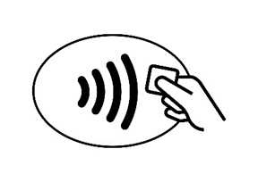



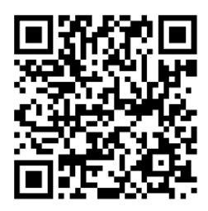

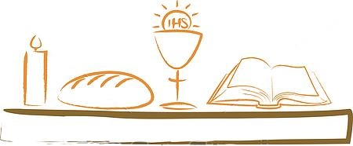


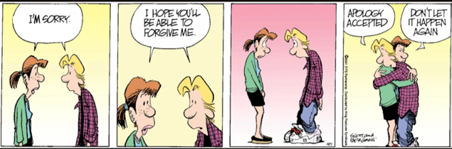

Christmas Mass Program
Dawn Masses December 16 - 24 5.30am
(no 9am Mass during this period)
Christmas Eve, Dec 24 Mass with Nativity 6pm
Midnight Mass 12am
Christmas Day, Dec 25 Christmas Day Masses 8am & 9.30am
New Years Day, Jan 1 New Year’s Day Mass 9am
Parish Diary Dates
Week 3 Rosters—Weekend Mass
Please notify Fr Walter you are in attendance
EMoE - 19 / 20 September
6:00pm: A. Enriquez
8.00am: J. Nealon
9:30am: M. Kastoun
Readers - 19 / 20 September
6:00pm: F. Cadeaux / I. Liew
8.00am A. Priya / M. Schinella
9.30am: E. Baini / P. Alexander
Junior Altar Servers - 19 / 20 September
6:00pm: J. Braganza / M. San Juan
8.00am: L. Harries
9.30am: G. Vicente
Senior Altar Servers - 19 / 20 September
6:00pm: C. San Juan
8.00am: A. Dave
9.30am: L. Vicente
If you are unable to attend your rostered date, please arrange a swap with another minister.
Fr Walter will be away for three weeks on Annual Leave from August 7 to August 28. Daily Parish Masses will be replaced
during this period by a Communion Service led by
Deacon Mick Flew on Monday, Tuesday, Wednesday & Friday at 9am.
Weekend Parish Masses will be held as usual - 6pm Vigil, 8am & 9.30am.
12 / 13 September 24th Sunday in Ordinary Time
  14 September Exaltation of the Holy Cross Feast
  15 September Our Lady of Sorrows Memorial
  16 September Sts Cornelius & Cyprian Memorial
18 September Diamond Jubilee Dinner – Waterview, Bicentennial Park
19 / 20 September 25th Sunday in Ordinary Time
27 September Tamil Community Mass 5.30pm
5/6 Sept—10/11 Oct Penance Enrolment forms available at weekend Masses
Holy Week & Easter Program
Passion/ Palm Sunday April 12/13 Mass 6pm, 8am, 9.30am
(with Blessing of Palms & Procession)
Holy Monday April 14 Mass 9am
Holy Tuesday April 15 Mass 9am
Holy Wednesday April 16 Mass 9am
Holy Thursday April 17
Mass of the Lord’s Supper 7pm
Solemn Reservation until 10pm
Friday of Passion of Lord April 18
Way of the Cross 10am
Celebration of the Lord’s Passion 3pm
Holy Saturday April 19
Easter Vigil (including Lucernarium) 7pm
Sunday of the Resurrection April 20 8am, 9.30am
The parish office will be closed from 23 - 30 December and operate on reduced hours during January 2023. It will return to regular 10am - 4pm Tuesday to Friday hours from 1 February 2023. For matters of importance during this time please email: office@sacredheartwestmead.com.au or telephone: 9635 9262 to leave a message.
The parish office will operate on reduced hours during January 2025. If the office is unattended during this time, for any matters of importance; to leave a message - Ph: 9635 9262 or email: office@sacredheartwestmead.com.au
Due to staff leave the parish office will be closed: Wednesday - Friday from August 9 - 11. For matters of importance during this time email: office@sacredheartwestmead.com.au
or phone: 9635 9262 to leave a message.
Announcements
Full dates and eligibility requirements for the Parish’s 2026 Sacramental Program
are listed on our website – www,sacredheartwestmead.com.au
Penance (Reconciliation) Program - Attendance is required at the following
17/18 October Enrolment Ceremonies at weekend Masses (6pm Vigil, 8am, 9.30am)
20 October Parent Meeting 7pm
28 October Groups start for 4 weeks
24 November Reconciliation Liturgy 6.30pm & 7.30pm
No 9am Daily Parish Mass Wednesday, 10 February
- no parish morning Mass due to opening school Mass.
The Bishop’s Father’s Day Appeal for Retired & Sick Priests was held the weekend of 5/6 September. This annual appeal raises funds for the Diocesan Clergy Support Foundation to continue its work of supporting retired clergy and those in ill-health. You can still donate to the Bishop’s Father’s Day Appeal
via the church envelopes or online: parracatholic.org/fathersdayappeal with Westmead as your parish.
’Tap & Go’ devices are installed in
our church. Select an amount and
tap your card on the logo to donate.
We thankyou
for your support of
Sacred Heart Westmead
Bishop’s Good Shepherd Appeal 29 / 30 May 2021 – supporting the
Seminarians & Holy Spirit Seminary When God calls, will you help them
answer? Your gift to Parramatta Catholic Foundation will support our
seminarians to prepare for the priesthood and a life of community
service. Please donate to the Bishop’s Christmas Appeal via envelopes in the church or online (specifying Westmead as your parish) at: parracatholic.org/appeal
We have raised $ 2200 towards our parish quota of $4600.
You can still donate to the Bishop’s Good Shepherds Appeal online at
parracatholic.org/appeal - specifying Westmead as your parish.
The Bishop’s Father’s Day Appeal for Retired & Sick Priests will be held the weekend of 3/ 4 September 2022. This annual appeal raises much needed funds for the Diocesan Clergy Support Foundation to continue its work of supporting retired clergy and those in ill-health. This year’s appeal will highlight the faithful service of our retired clergy, and in particular, Mons John Boyle, Fr Chris Dixon and Fr Bob Sheridan. Please give generously to the Bishop’s Father’s Day Appeal via the church envelopes or online at parracatholic.org/fathersdayappeal
Todays Message Dianne Bergant
A distinctive feature of the teachings of Jesus is his exhortation to forgive. Very explicit about this, Jesus left us his own example by forgiving his executioners while he hung dying on the cross. Until recently we thought that forgiveness begins with the offender repenting of the offence and then asking for pardon. Today many maintain that reconciliation must begin with the one offended offering forgiveness. This willingness to forgive transforms a victim into a survivor. Such magnanimity might then touch the heart of the offender, who may thus be transformed from being an offender to becoming a friend. If God has been so generous in forgiving us, surely we should be generous in forgiving others. The process of becoming a forgiving person takes time. For some, it may take a lifetime. Only little by little are our pettiness and indignation reduced and our desire to strike back diminished. Still, as disciples, we are expected to give the forgiveness that we have been given. Such forgiveness does not provide an easy way out for offenders, for ultimately justice will prevail. If we remain untransformed by God’s forgiveness of us, we will be liable to judgment. Our unwillingness to forgive can eat away at us, and we can carry hurts from childhood far into adult years. Forgiving others, as difficult as that may be, is in the long run much easier than bearing the weight of resentfulness, vindictiveness and unresolved frustration. When we forgive we truly begin to be healed.
‘In Memoriam’: for the month of November
November is a special time to pray for the faithful departed. The Church encourages the offering of prayers or Masses. Envelopes are available in the church for all those wishing to offer Mass for deceased loved ones during November.
All Mass intentions will be recorded in our ‘In Memoriam’ booklet in the church.
Help fund our New Church Essentials
Thank you for your generosity in supporting Westmead New Church Giving. There are two ways to give: Sponsor a Pew, or help fund priority items from our Essentials List on the Westmead New Church Giving forms in the church. To have your gift recognised, complete a form or email details so we may reconcile your donation. Please take a form today, scan the QR code, or online sacredheartwestmead.com.au/Newchurch
No Parish Mass
Friday 18 September
due to School
Mercy Day Mass
Join Sacred Heart Parish Westmead in celebrating our Diamond Jubilee on Friday 18 September 2026 at 6:30pm at Waterview Function Centre,
Bicentennial Park. All funds raised going towards building the new parish church. Tickets are $160.
For ticket enquires,
scan the QR code
or see flyer in the church
or on the website.
Pentecost Sunday - Vigil Mass
All Souls’ Day Masses: 2 November
To commemorate
All Souls’ Day on
Wednesday
2 November 2022
Mass will be
celebrated as follows:
Sacred Heart Westmead: 9am & 7pm
Entrance Antiphon: Vigil Bar 5:5
Arise, Jerusalem, and look to the East
and see your children gathered
from the rising to the setting of the sun.
First Reading: Vigil Is 60:1-6
The glory of the Lord shines upon you.
Responsorial Psalm: Vigil
Ps 71:1-2. 7-8. 10-13. R.v.11
R. Lord, every nation on earth will adore you.
Second Reading : Vigil Eph 3:2-3. 5-6
The revelation means that
pagans now share
the same inheritance,
that they are parts
of the same body.
Gospel Acclamation: Vigil Mt 2:2
Alleluia, alleluia!
We have seen his star in the East;
and have come to adore the Lord. Alleluia!
Gospel: Vigil Mt 2:1-12
We have come from the East
to worship the king.
Communion Antiphon: Vigil Rev 21:23
The brightness of God
illumined the holy city Jerusalem,
and the nations will walk by its light.
Parish Registration Welcoming all to our parish community
Sacred Heart Parish is once again undertaking an update of all our parish information. It is an opportunity for all in our parish community to update contact and sacramental details for each member of your family. The parish conducts a Planned Giving Program (PGP) to raise the funds necessary to establish & maintain parish facilities. Those currently registered with the PGP may like to update their contribution details, while those new to our parish are invited to register in the program to receive a set of weekly contribution envelopes.
Due to staff leave the parish office will be closed: Friday 18 September 2026. For matters of importance during this time phone: 9635 9262 to leave a message or email: office@sacredheartwestmead.com.au
At Sacred Heart Westmead, Baptism
is celebrated on the first Sunday
of the month at 11am.
Please contact the
parish office to book for 2026.
Grant Eternal Rest to the
recently deceased and those
we remember at this time . . .
James & Josephine Knight
John & Madeleine Brown
Habib Eltakchi; Bill Eltakchi
The Second collection (which includes the ‘Planned Giving Program’ (PGP) is the main source of parish income. Funds collected are used in the running of our parish, and to establish and maintain our parish ministries, buildings and facilities. Envelopes are used in the PGP and deposited in the Second Collection at weekend Mass. Those currently registered with the PGP may like to update their contribution details, while those new to our parish are invited to register with the program to receive a set of weekly contribution envelopes. Registration forms are available on the table at the entrance to the church or from the parish website; which once completed, should be returned to the parish office, via email, the mailbox or in weekend collection bag.
The PGP (in the 2nd collection) is the main source of parish income. Funds collected are used in the day to day running of our parish and in maintaining our church and parish buildings.
Your Donations at Weekly Mass
· First Collection - Supports the clergy of the Parramatta Diocese
· Second Collection - Supports the day to day running and maintenance of Sacred Heart Parish church, buildings, programs & ministries
Please help support our parish by donating to the second collection through cash, the ‘TAP’ machine or by joining the Planned Giving Envelope collection.
Next Sunday’s Readings: 19/20 September
25th Sunday in Ordinary Time
1st Reading: Is 55:6-9
2nd Reading: Phil 1:20-24, 27
Gospel: Mt 20:1-16
Online Safeguarding Training Modules are always available for those in ministry and all in our parish community. The modules offer valuable insights into recognising abuse and protecting those in our community who are vulnerable. All modules are free and can be completed at your own pace. To register for these learning modules: https://learning.safeguarding.org.au/

